Slide 1
Protection Mechanisms
Module 7
In this presentation:
Lab Exercises (Part One) | Lab Exercises (Part Two)
Introduction to Passwords | Introduction to Firewalls
Password Cracking and Protection | Windows Firewall Configuration
Protection Mechanisms

Slide 2
Lab Exercises (Part One)
In the first part of this module, you will:
Launch the TEATalk Client and open a chat session. Your group will be assigned a chat room and a central server.
Generate chat traffic, which will be captured and posted for your analysis.
Use forensic tools to identify captured chat data, then use a simple password cracker to mount a brute-force attack on this data. After you discover the chat passwords of other users, you will use them to invade their chat rooms.
(See the lesson plan instructions for more information.)
Protection Mechanisms > Lab Exercises (Part One)

Slide 3
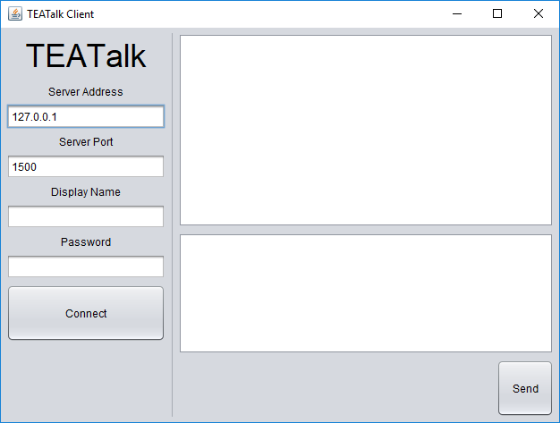
Lab Exercises (Part One)
Server Address
Chat Activity
Server Port Number
Display Name
Chat Room Password
New Messages
TEATalk Client (requires that a current version of Java SE is installed).
Protection Mechanisms > Lab Exercises (Part One)

Slide 4
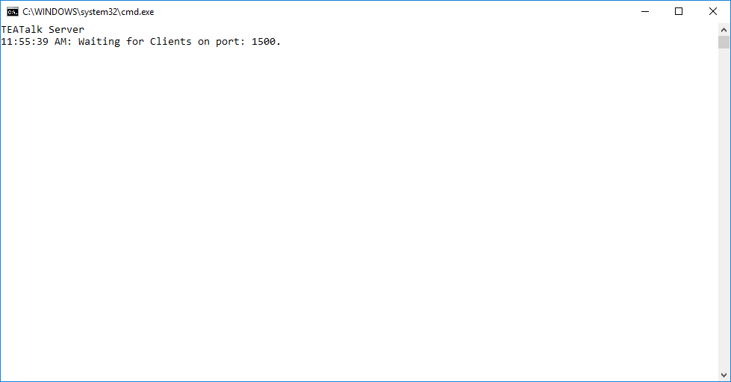
Lab Exercises (Part One)
TEATalk Server (requires that a current version of Java SE is installed). Messages from the clients, or error messages, will appear in this window.
Protection Mechanisms > Lab Exercises (Part One)

Slide 5
Introduction to Passwords
A password (or passphrase) is a sequence of characters that is used to prove one’s identity. Passwords allow their owners to gain access to a protected resource that is to be kept secret from those who do not have the password. They are typically stored as hashes, or signatures derived from the characters of the original password.
Providing a user name and a password to a system is one of the most common ways of identifying yourself and proving that your identity is genuine. Authentication is the act of comparing the provided credentials with those on record; if the credentials match, they are accepted, and you are allowed access.
Protection Mechanisms > Introduction to Passwords

Slide 6
Introduction to Passwords (cont’d)
An ideal password is one that is easy for you (the owner) to remember, but difficult for others to guess. The second characteristic is important because an attacker may be interested in the data that is protected by your password, or in using your identity for some unauthorized purpose, or both.
Anything that makes your password more difficult to guess reduces the likelihood that it will be compromised. However, making a password more difficult to guess may also make it harder to remember.
Protection Mechanisms > Introduction to Passwords

Slide 7
Introduction to Passwords (cont’d)
To protect their users’ information, many organizations require certain characteristics of the passwords they will accept in order to make the passwords as strong as possible. These characteristics include:
Length (typically a minimum of eight characters or more)
Range (passwords may be required to include upper and lowercase letters, numbers, and special characters/symbols)
Forbidden elements (typically, passwords cannot include dictionary words or personal information that would be easy for others to find)
Protection Mechanisms > Introduction to Passwords

Slide 8
Introduction to Passwords (cont’d)
Passwords that are composed according to these policies are more difficult to guess than those which are not. However, passwords are still vulnerable to cracking, which is the act of recovering passwords from encrypted data.
Password cracking typically involves capturing a copy of this data (from a file, from a network, etc.) and attempting to decrypt it with multiple guesses of the password. If the decryption succeeds, or if the cryptographic hash of the guessed password matches that of the original, the crack is successful.
Protection Mechanisms > Introduction to Passwords

Slide 9
Introduction to Passwords (cont’d)
The time required to crack a password depends on several factors. The strength of the password (as defined earlier) is one factor, as is the way in which candidate passwords are chosen. The simplest way is a brute-force attack, or simply guessing every possible permutation of a password.
A brute-force attack may require a large number of guesses, so more sophisticated password cracking tools use other methods to minimize the number of guesses. These include dictionary attacks (passwords derived from a list of words) and rainbow tables (precomputed values for known hashing algorithms). John the Ripper is one freely-available dictionary attack tool. For this exercise, we will use TEACracker, a brute-force password cracker designed for use with TEATalk.
Protection Mechanisms > Introduction to Passwords

Slide 10
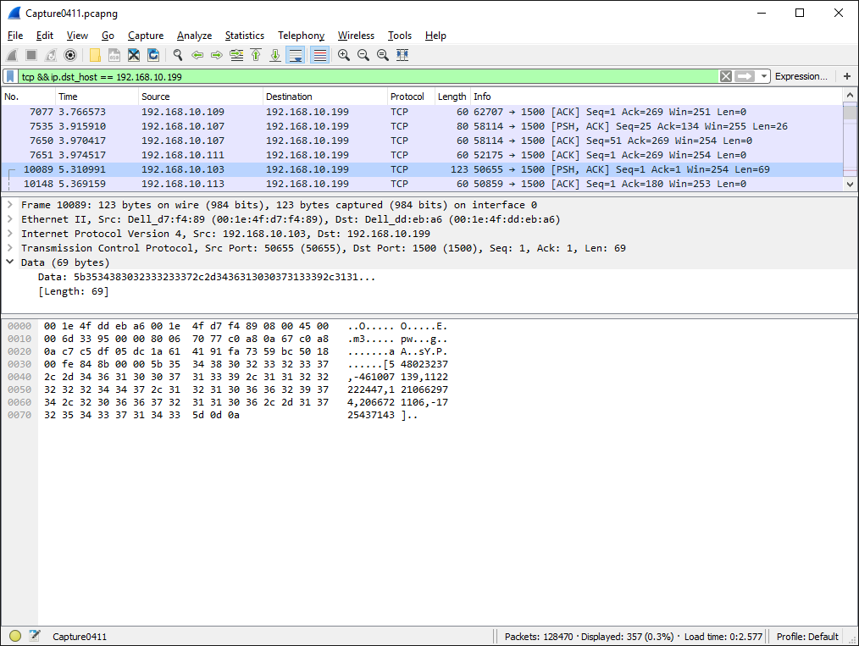
Introduction to Passwords (cont’d)
Wireshark, the protocol analyzer we will use to analyze captured chat traffic. One packet from an encrypted chat conversation is shown above.
Protection Mechanisms > Lab Exercises (Part One)

Slide 11
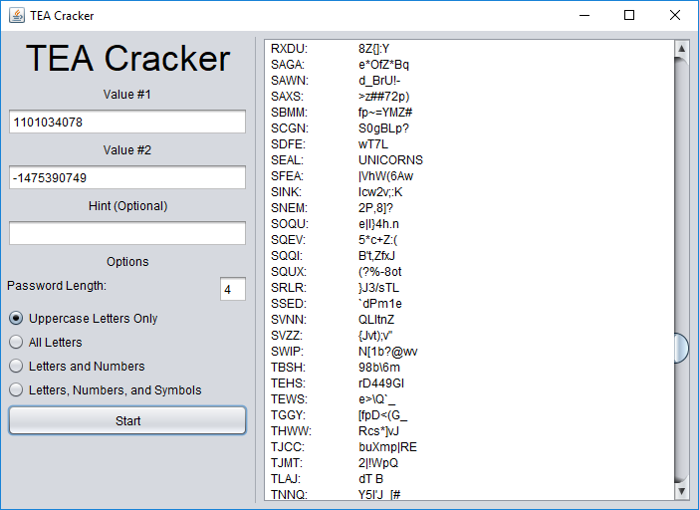
Introduction to Passwords (cont’d)
Encrypted TEA Value 1
Attempted Passwords
Encrypted TEA Value 2
Decrypted text (includes false positives)
Plaintext “hint” to look for
Cracking Options
TEACracker (requires Java SE). Here, we have found a valid password; the other passwords yielded only “false positives” in the form of “garbage” plaintext.
Protection Mechanisms > Lab Exercises (Part One)

Slide 12
Password Protection
So, how long would it take TEACracker to complete a brute-force attack on passwords of different levels of complexity? Assume a worst-case scenario, in which every password has to be tested before arriving at the correct one.
During one test run, every possible password of four capital letters was tested within about 1.45 seconds. That’s 456,976 possible passwords, or about 0.000003173 seconds per password. From that, we can extrapolate these estimates for passwords of the following types:
Four capital/lowercase letters (7,311,616 passwords): ~23 seconds
Eight capital/lowercase letters (53,459,728,531,456 passwords): ~5.37 years
Eight letters/numbers/symbols (7,837,433,594,376,961 passwords): ~788 years
Ten letters/numbers/symbols (73,742,412,689,492,826,049 passwords): ~7,419,605 years
(Of course, more intelligent attacks, such as dictionary attacks, can significantly reduce the time needed to crack a password.)
Protection Mechanisms > Password Protection

Slide 13
Password Protection (cont’d)
Making passwords harder to guess (and harder to crack) by placing all of the burden on the user is counterproductive beyond a certain point. If a password is too hard to remember, it is often written down (look for sticky notes on monitors or keyboards!) or saved in an insecure file, which compromises its security.
Using salt is one way to strengthen passwords. A cryptographic salt is extra data, unique to every new password, which is joined to the password before the hash (signature) is generated. The hash and the salt are typically stored together. Salting effectively makes a password longer, without requiring the user to memorize a longer password.
Protection Mechanisms > Password Protection

Slide 14
Lab Exercises (Part Two)
In the second part of this module, you will:
Launch the TEATalk Server on one of the workstations in your group.
Configure the Windows Firewall to add a firewall rule allowing incoming connections from other workstations in your group running the TEATalk Client. The group will collaborate in testing this new rule.
Enable logging on the new rule, so that new chat connection attempts are automatically logged.
(See the lesson plan instructions for more information.)
Protection Mechanisms > Lab Exercises (Part Two)

Slide 15
Introduction to Firewalls
The purpose of a firewall is to moderate and control network traffic, for the purpose of logging network activity and/or blocking potentially harmful traffic.
Firewalls provide a layer of protection between personal computers and networks, or between private (trusted) networks and public (untrusted) networks. This need has become increasingly important as more and more individuals and organizations are connected to the Internet.
An improperly configured firewall can provide a false sense of security, so it is important to be able to tailor a firewall configuration to your needs.
Protection Mechanisms > Introduction to Firewalls

Slide 16
Introduction to Firewalls (cont’d)
One common category of firewalls is a software firewall, a standard component of modern operating systems. The firewall included with Microsoft Windows is the Windows Firewall.
The firewall checks incoming and outgoing network packets based on its set of rules, to determine whether the packet should be rejected or forwarded to its intended destination.
When a rule which matches the packet is found, the corresponding rule action is obeyed.
Protection Mechanisms > Introduction to Firewalls

Slide 17
Windows Firewall
Windows Firewall rules are divided into profiles. When you set up a network connection for the first time, your choice of profile determines the rules which will govern that connection:
Public (for shared networks that are not “trusted”; are more tightly regulated than Private networks)
Private (for home networks and other “trusted” locations; more services are enabled by default than on Public networks)
In addition, rules can be specified for both inbound and outbound network traffic. Inbound traffic is blocked by default unless it matches one of the firewall rules, while outbound traffic is allowed by default.
Protection Mechanisms > Windows Firewall

Slide 18
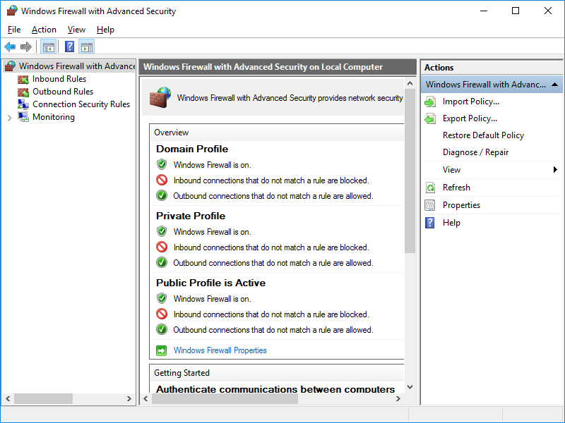
Windows Firewall (cont’d)
Windows Firewall
Protection Mechanisms > Windows Firewall

Slide 19
Windows Firewall (cont’d)
The default Windows Firewall configuration is a reasonably secure starting point for most systems, but it is sometimes necessary to create a new rule to permit a networked application or service to function.
This can often be done automatically, but in this module, we will explore the process of manually configuring a new rule.
This will help you to become more familiar with the default firewall configuration, and also with the optional facilities (such as logging) that can be enabled for firewall rules.
Protection Mechanisms > Windows Firewall

Slide 20
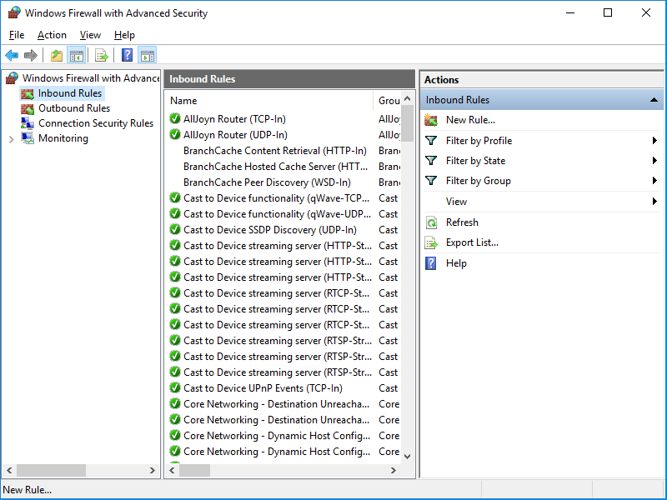
Windows Firewall (cont’d)
Windows Firewall: Inbound Rule Configuration
Protection Mechanisms > Windows Firewall

